Slide 1
A river of diversity: cultural and biological variation in Amazonian yuca (cassava, manioc)
Stephen Wooding, PhD
University of California, Merced
César Peña
Amazon Scientific Research Support

Slide 2
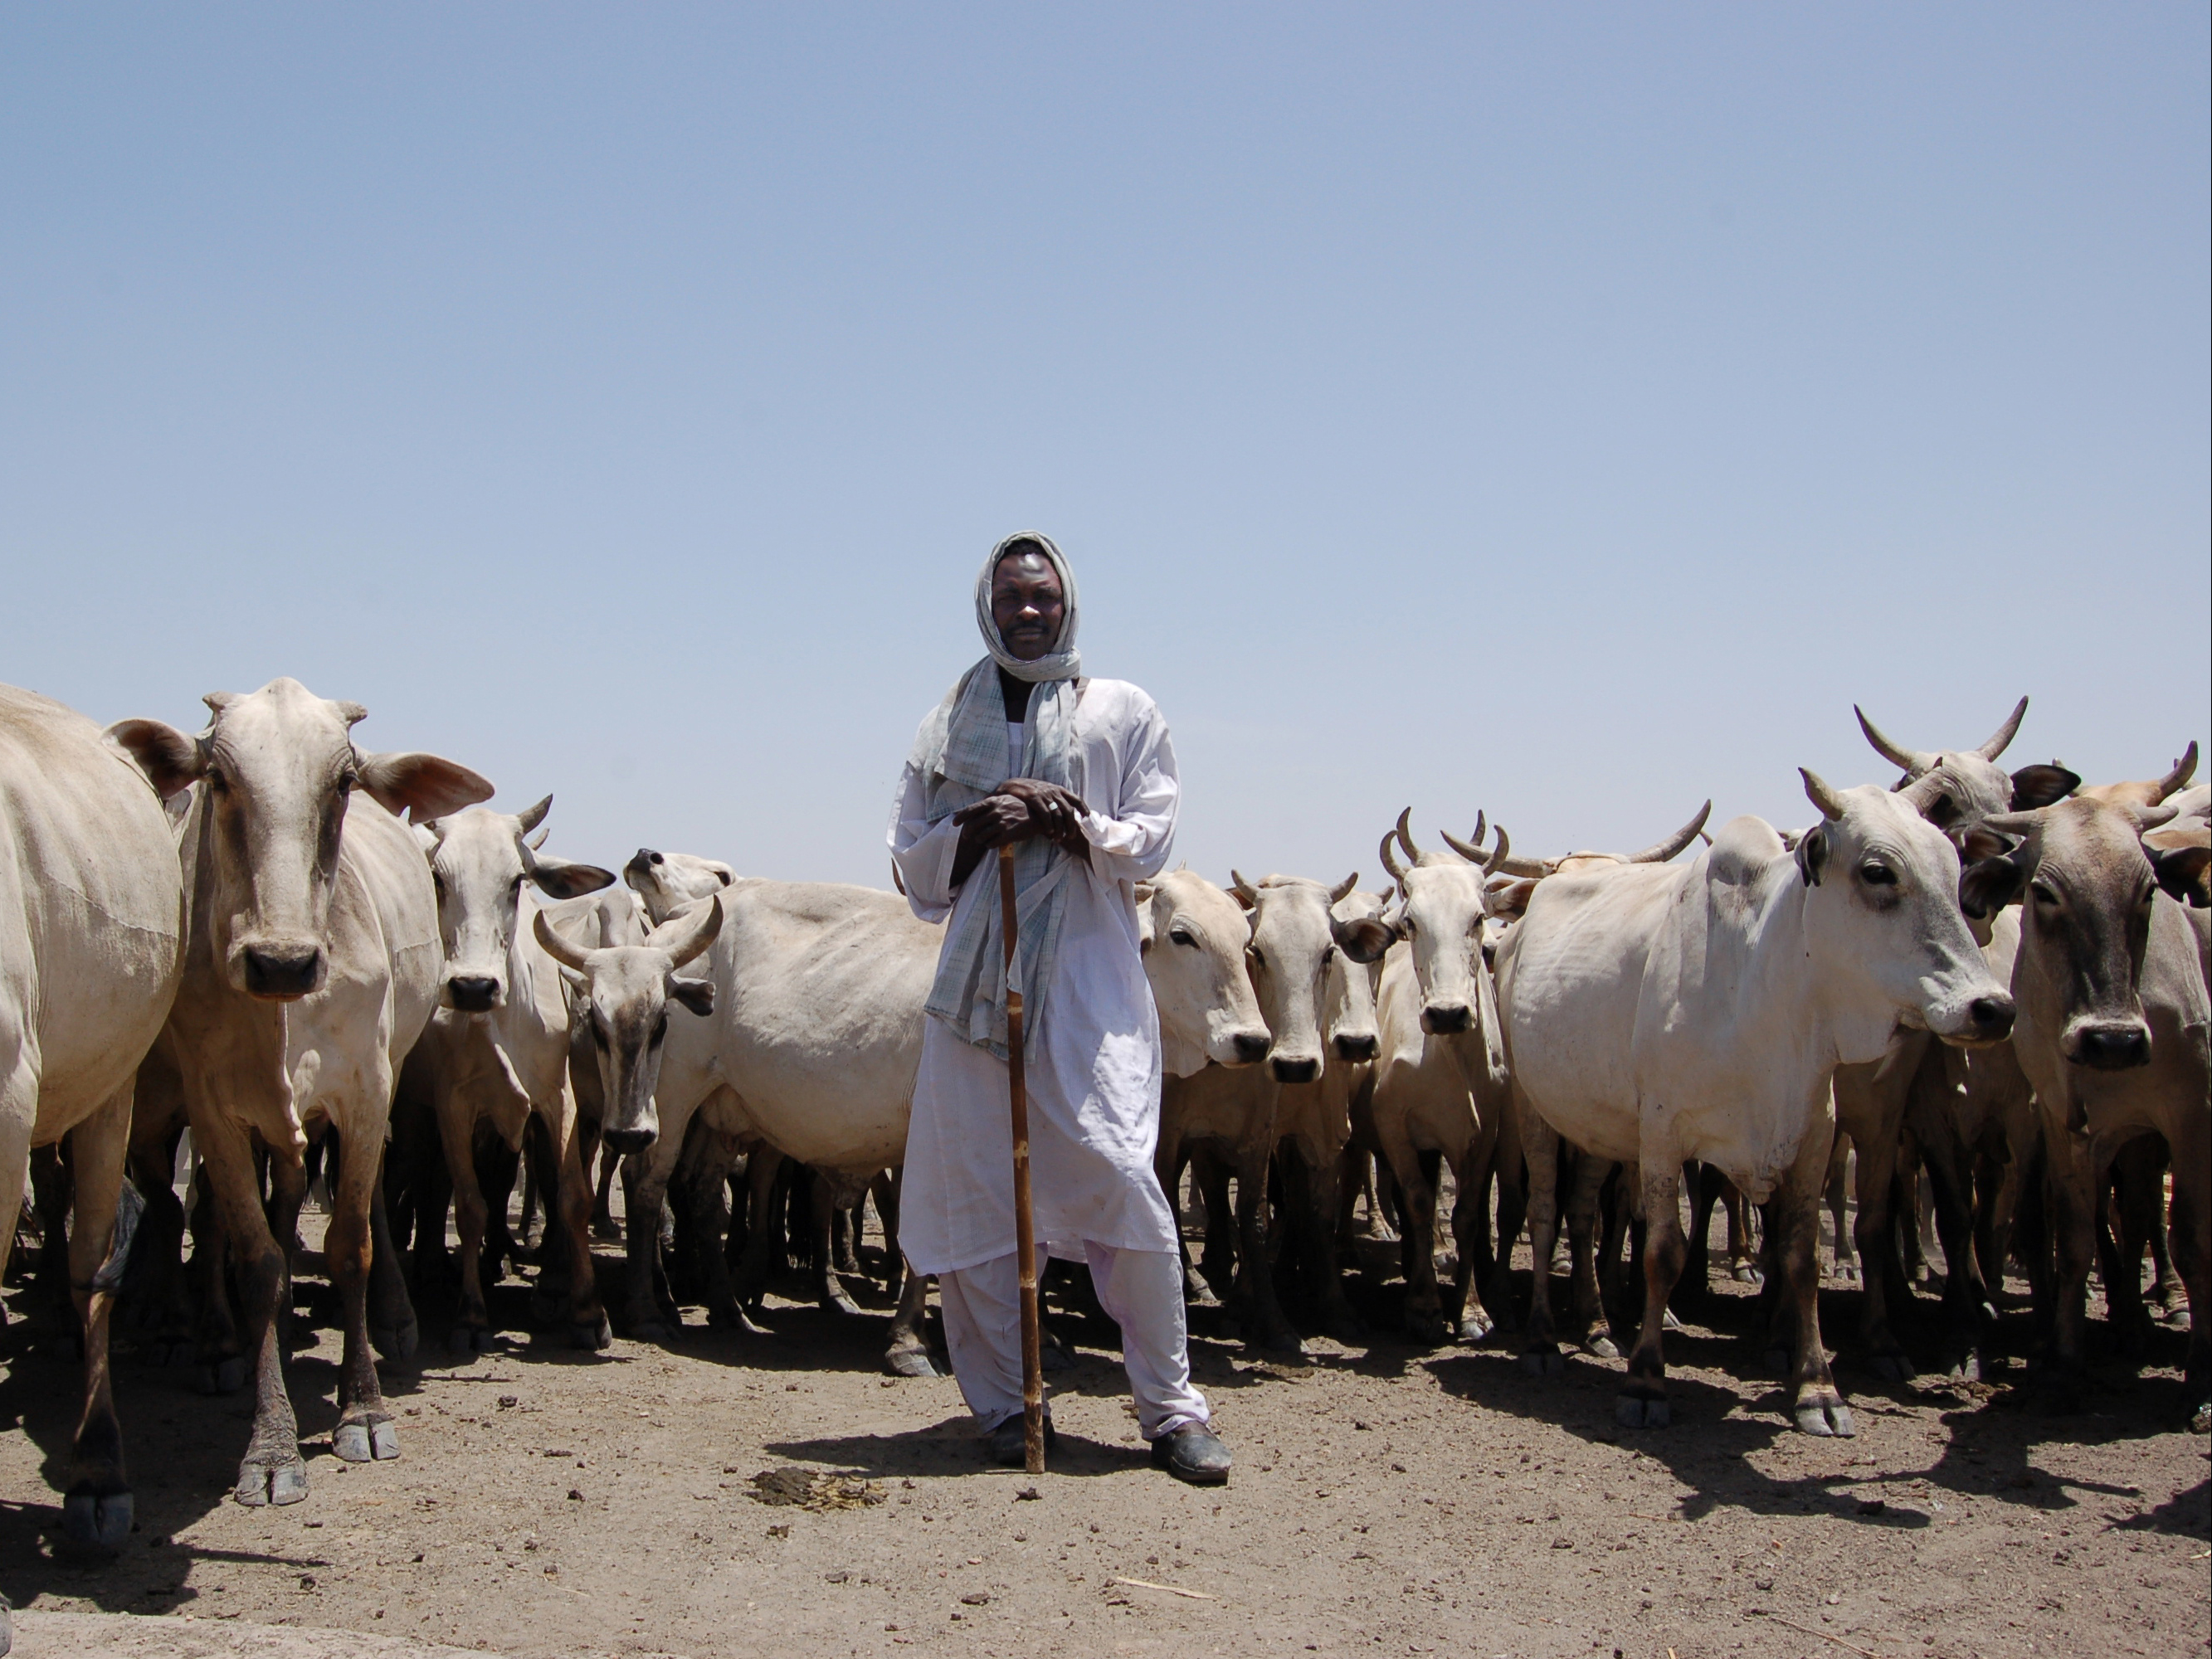
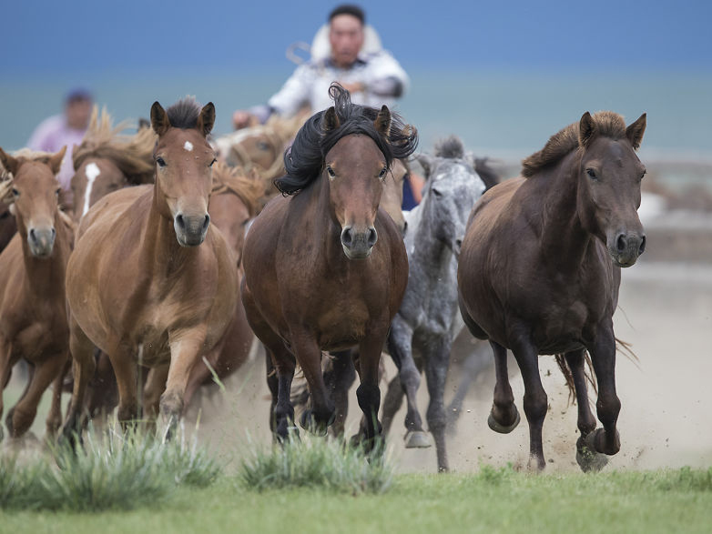
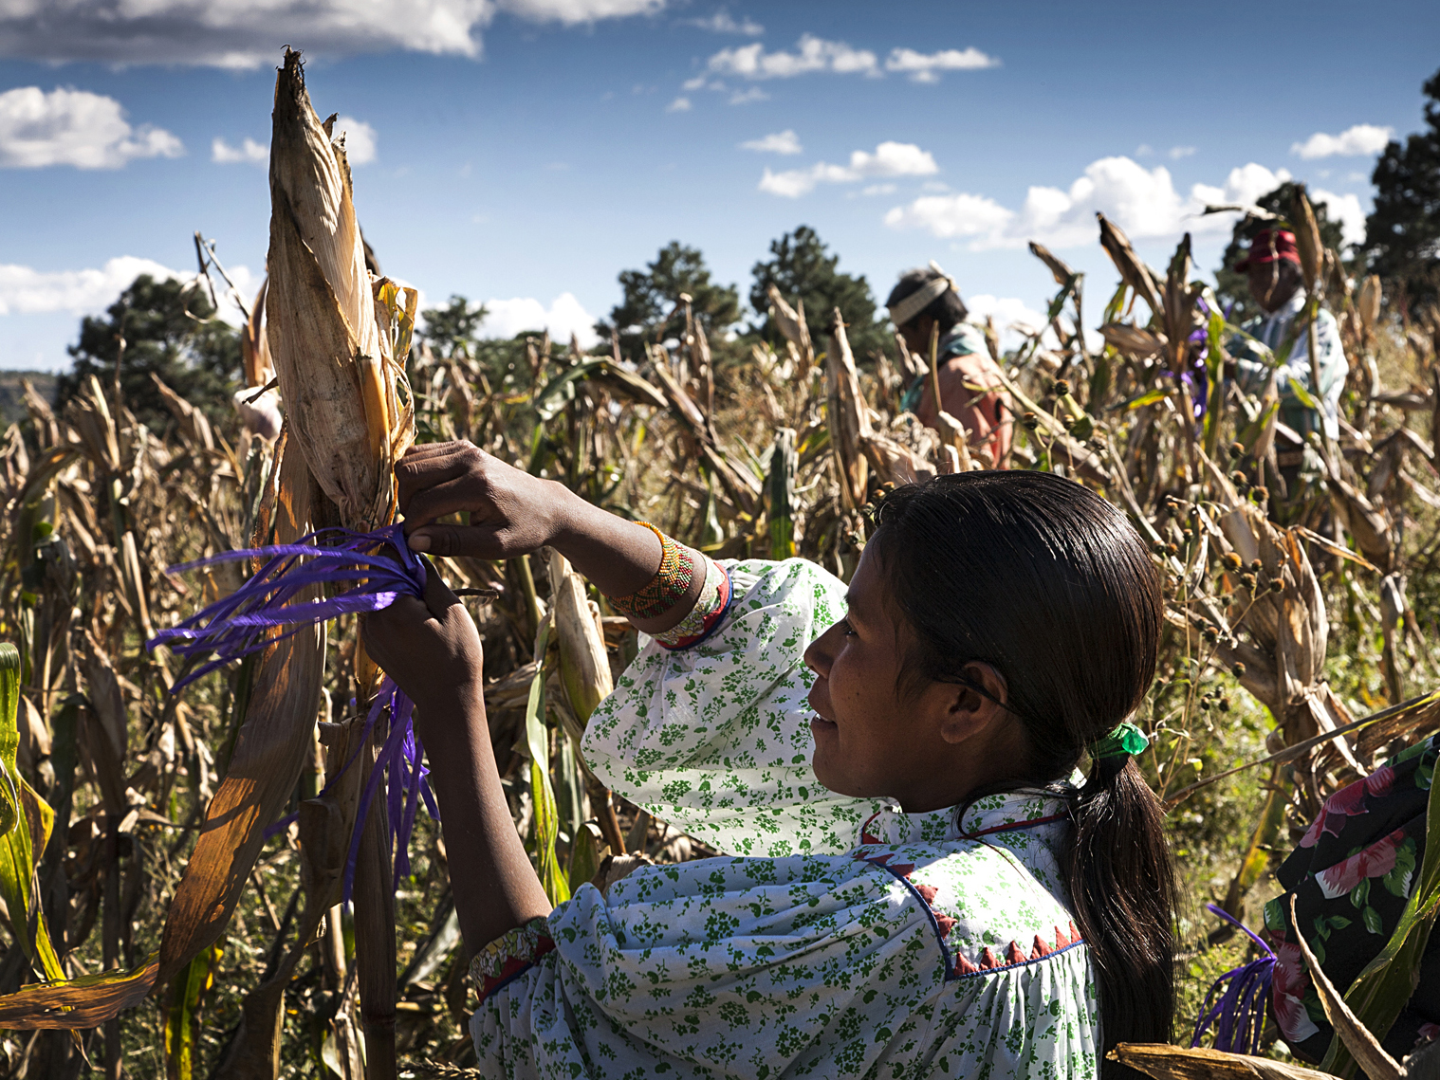
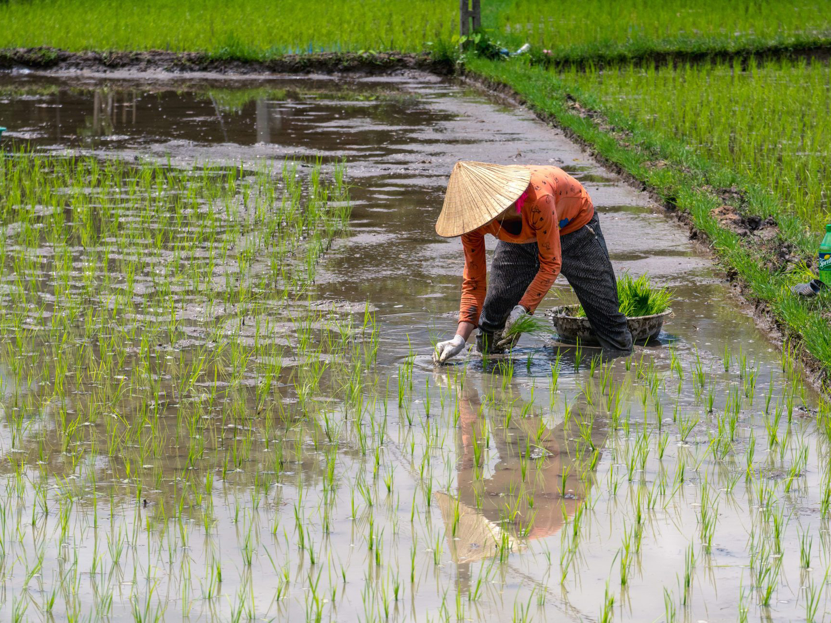

Slide 3
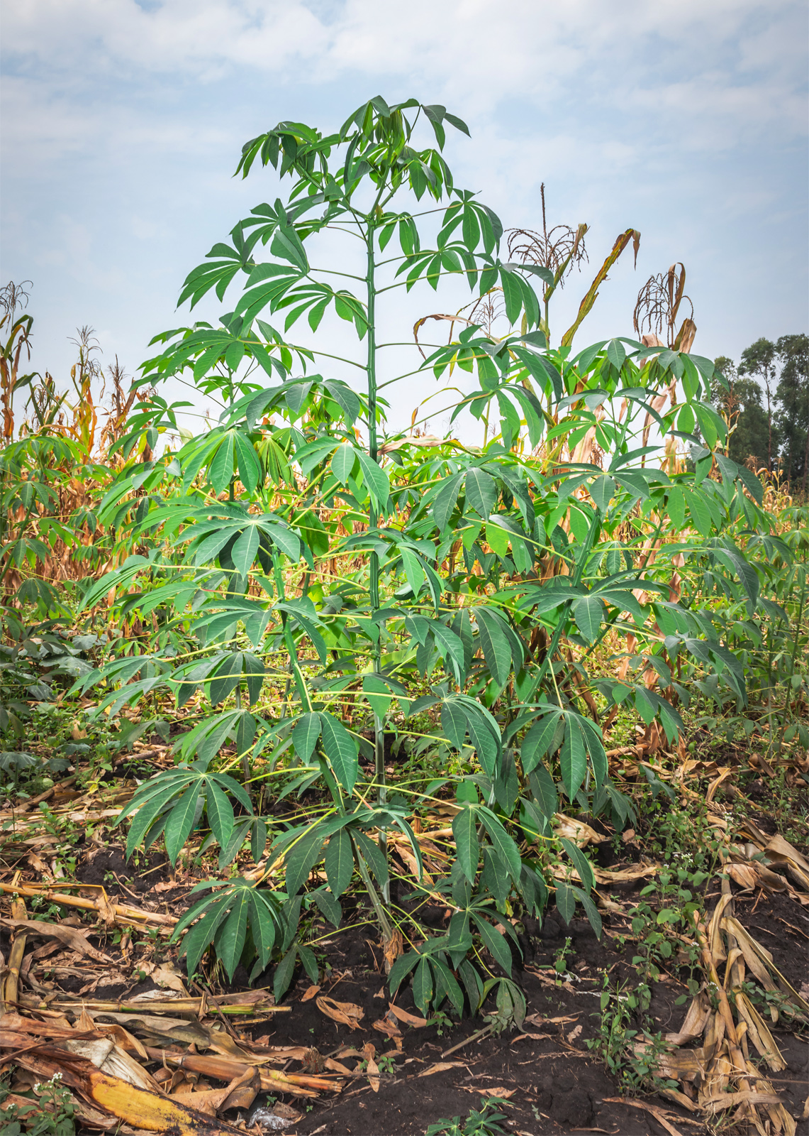
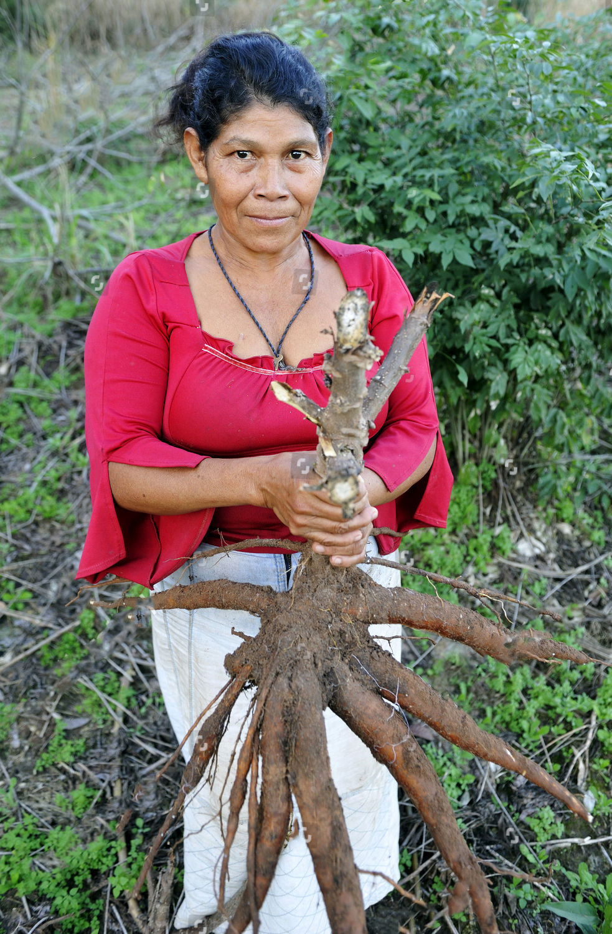
Yuca
© Florian Kopp / Alamy Stock Photo
© Florian Kopp / Alamy Stock Photo

Slide 4
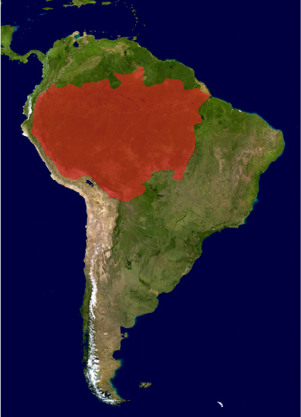

Slide 5
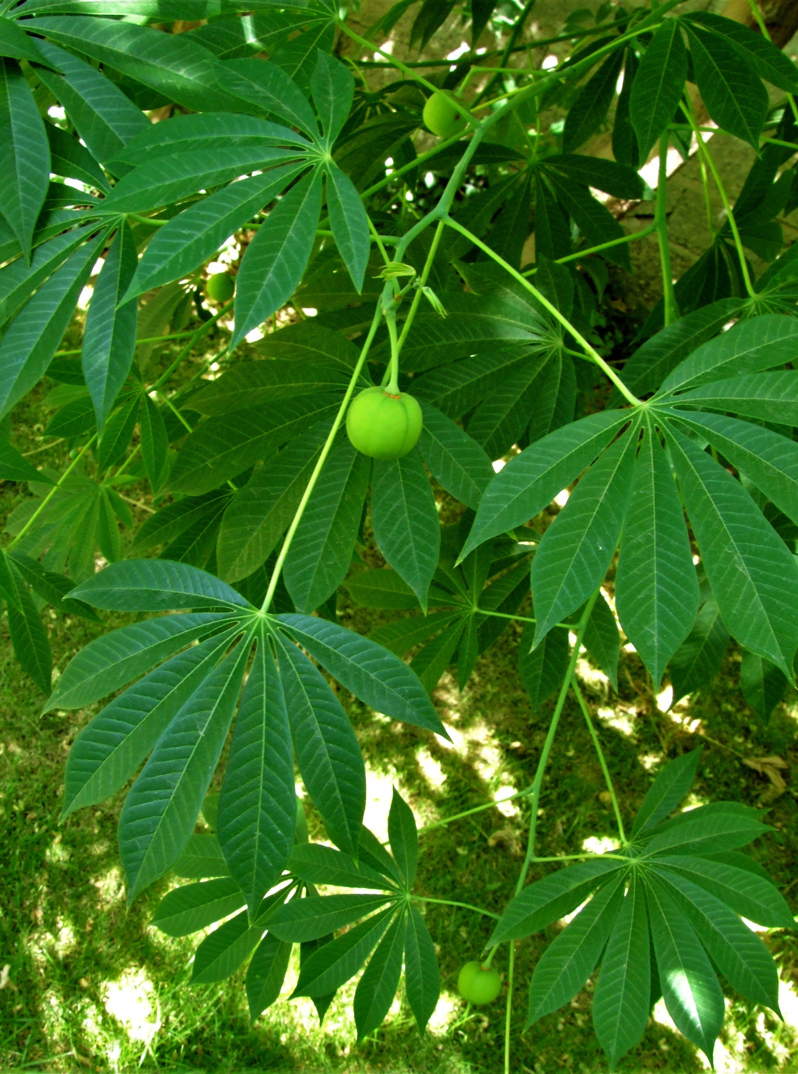
What were the processes?
Culture
Biology
Manihot flabellifolia
Manihot esculenta
High Toxicity
Low Toxicity
Low Productivity
High Productivity

Slide 6
Approach
In a focal region
Collect:
Phenotypic data
Morphology
Nutrition (starch content)
Cyanide production
Geographic data
Cultural data
Nomenclature, use

Slide 7
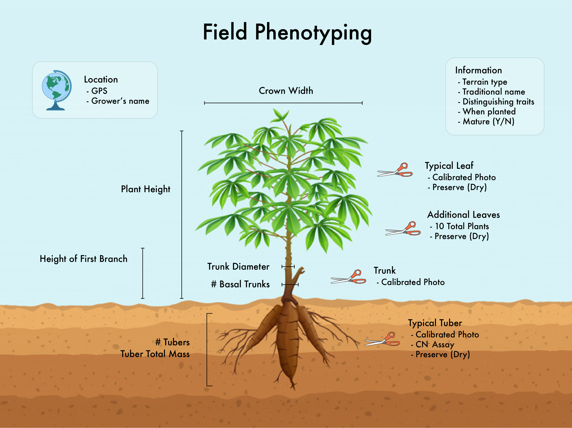

Slide 9
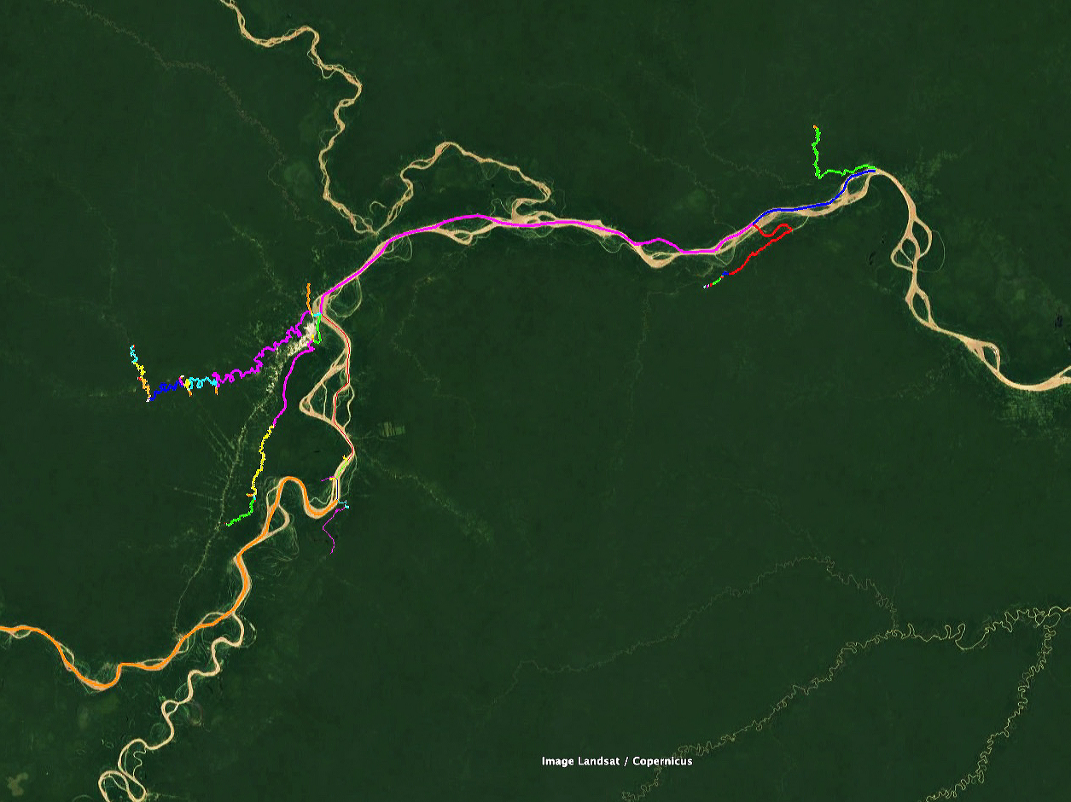
Ampiyacu
Iquitos
Orosa
Pintuyacu
Nanay
Itaya
Tahuayo

Slide 10
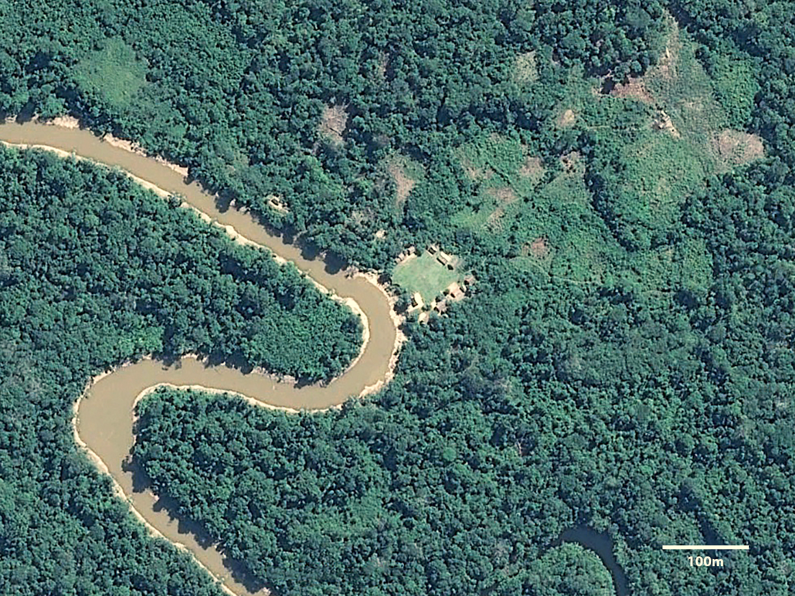

Slide 11
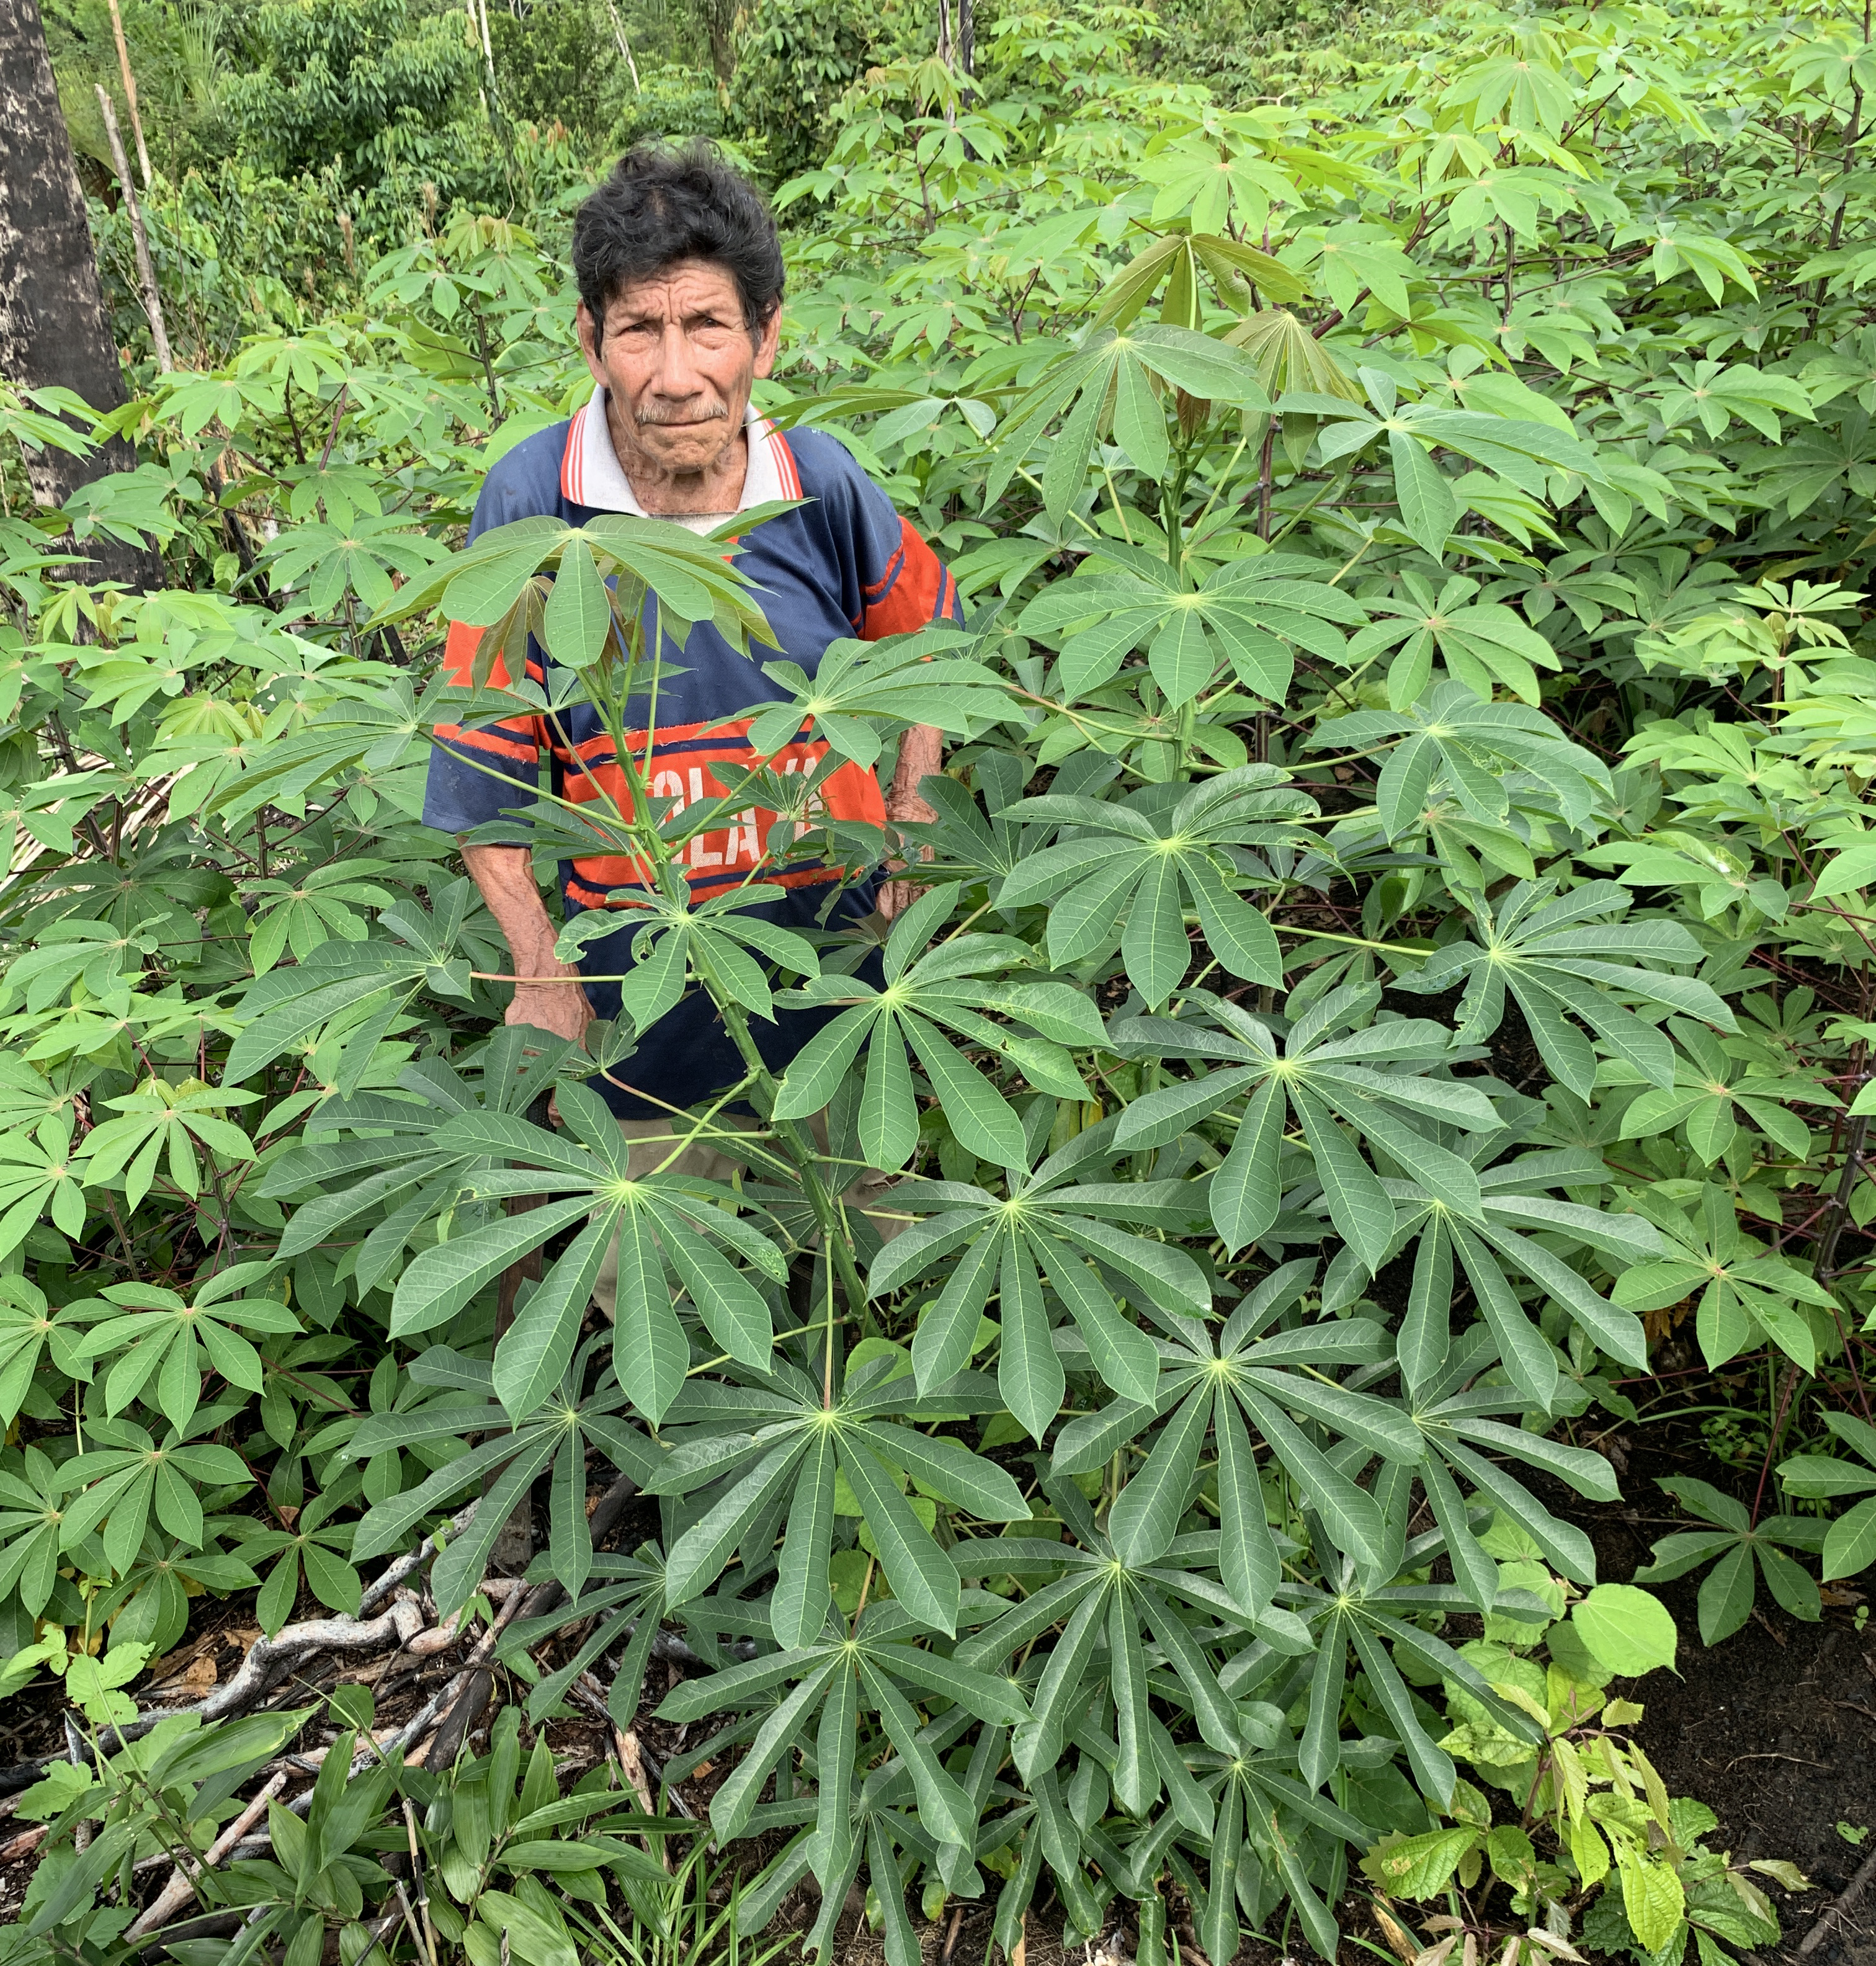
Cultural Observations

Slide 12
49 Cultivars Collected
amarilla
añera
andioca
palo negro Antonio
arahuana
palo negro Arimuya
arpón
blanca
blanca (palo negro)
blanca (palo blanco)
brava (cultivated)
brava (wild)
buena
bufeo
caballo
cerveza yuca
cogollo morado
crema
dulce
gallinazo
hungurahui
iguano
indianino
inviernino
lobera
lobera colorada
lobera negra
lupuna
lupunillo
mandioca amarilla
mano de tunche
morada
morada amarilla
motelillo
motelo
napino
palo negro
palmera
palo blanco
piririca
posheco enano
posheco gigante
puca umishina
rinrisho
señorita
umishina
vidrio
viejillo
yahua

Slide 13
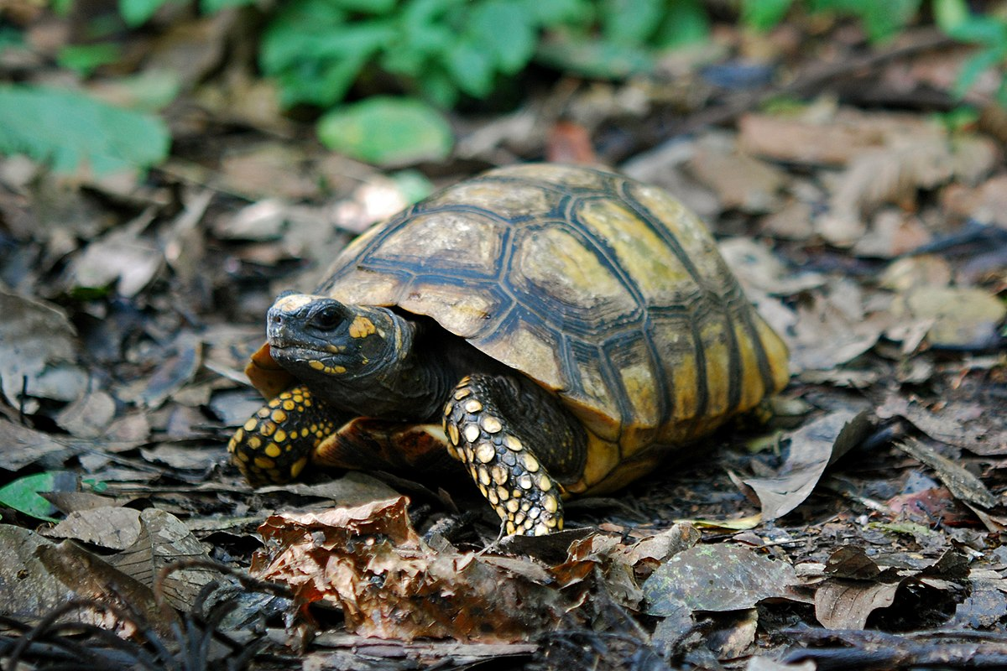
49 Cultivars Collected
amarilla
añera
andioca
palo negro Antonio
arahuana
palo negro Arimuya
arpón
blanca
blanca (palo negro)
blanca (palo blanco)
brava (cultivated)
brava (wild)
buena
bufeo
caballo
cerveza yuca
cogollo morado
crema
dulce
gallinazo
hungurahui
iguano
indianino
inviernino
lobera
lobera colorada
lobera negra
lupuna
lupunillo
mandioca amarilla
mano de tunche
morada
morada amarilla
motelillo
motelo
napino
palo negro
palmera
palo blanco
piririca
posheco enano
posheco gigante
puca umishina
rinrisho
señorita
umishina
vidrio
viejillo
yahua

Slide 14
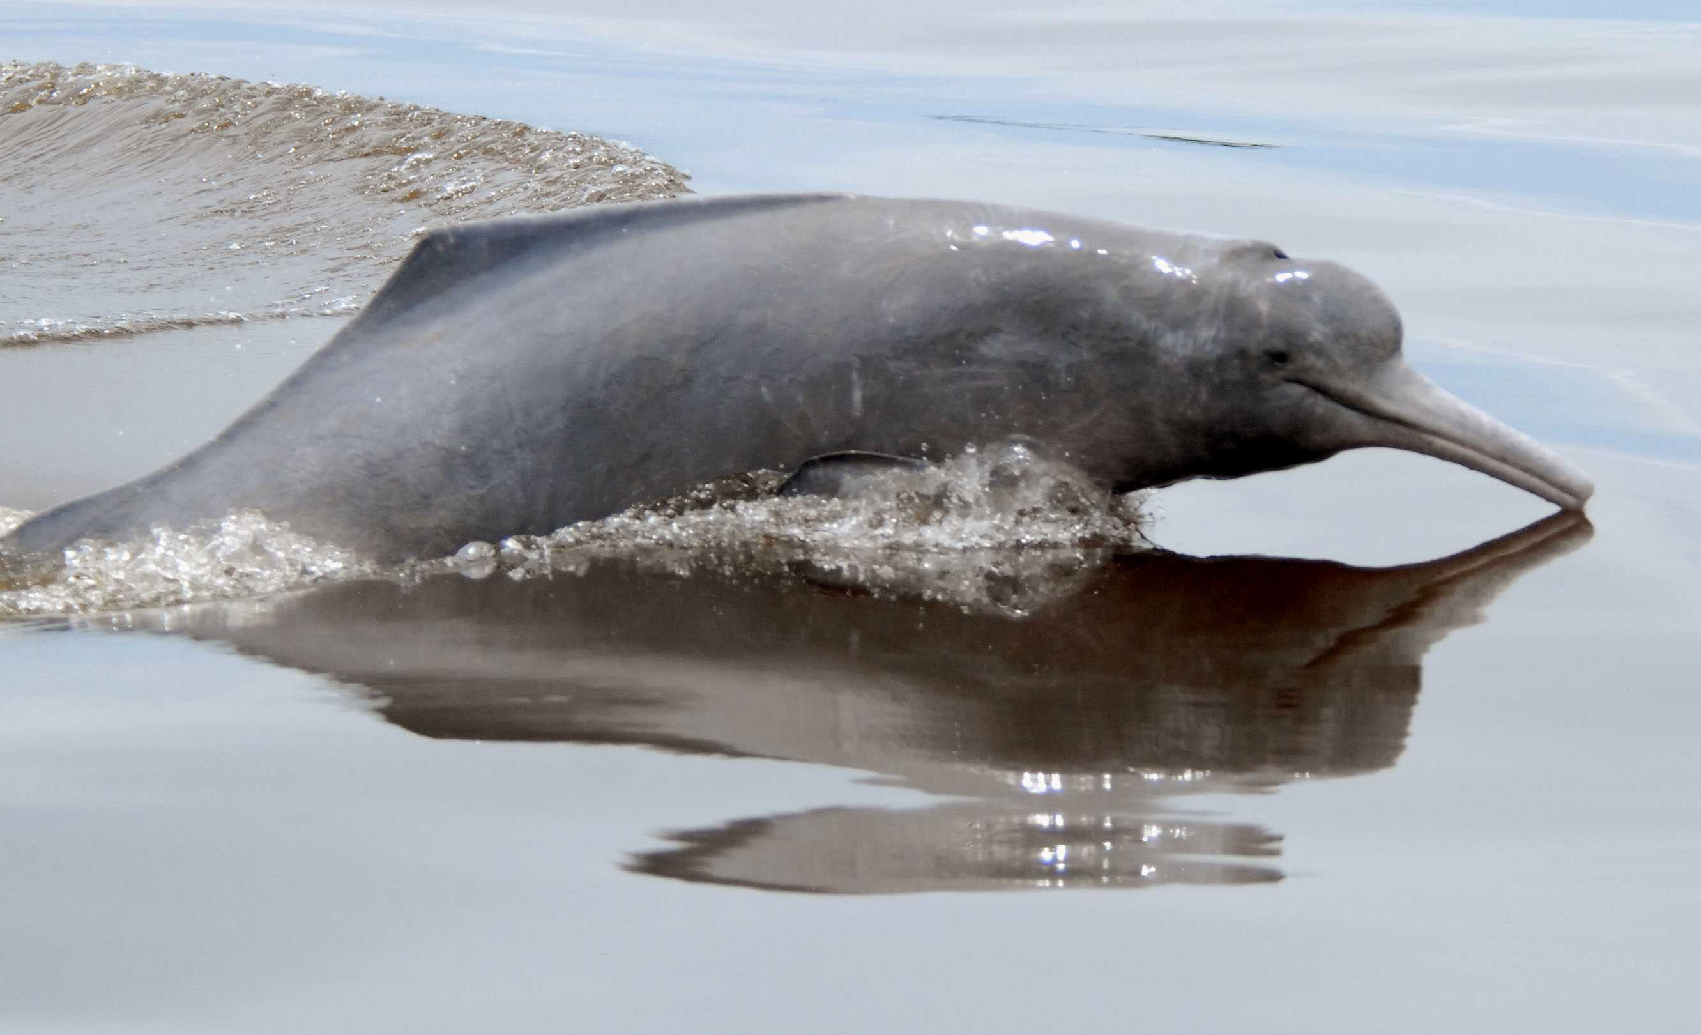
49 Cultivars Collected
amarilla
añera
andioca
palo negro Antonio
arahuana
palo negro Arimuya
arpón
blanca
blanca (palo negro)
blanca (palo blanco)
brava (cultivated)
brava (wild)
buena
bufeo
caballo
cerveza yuca
cogollo morado
crema
dulce
gallinazo
hungurahui
iguano
indianino
inviernino
lobera
lobera colorada
lobera negra
lupuna
lupunillo
mandioca amarilla
mano de tunche
morada
morada amarilla
motelillo
motelo
napino
palo negro
palmera
palo blanco
piririca
posheco enano
posheco gigante
puca umishina
rinrisho
señorita
umishina
vidrio
viejillo
yahua

Slide 15
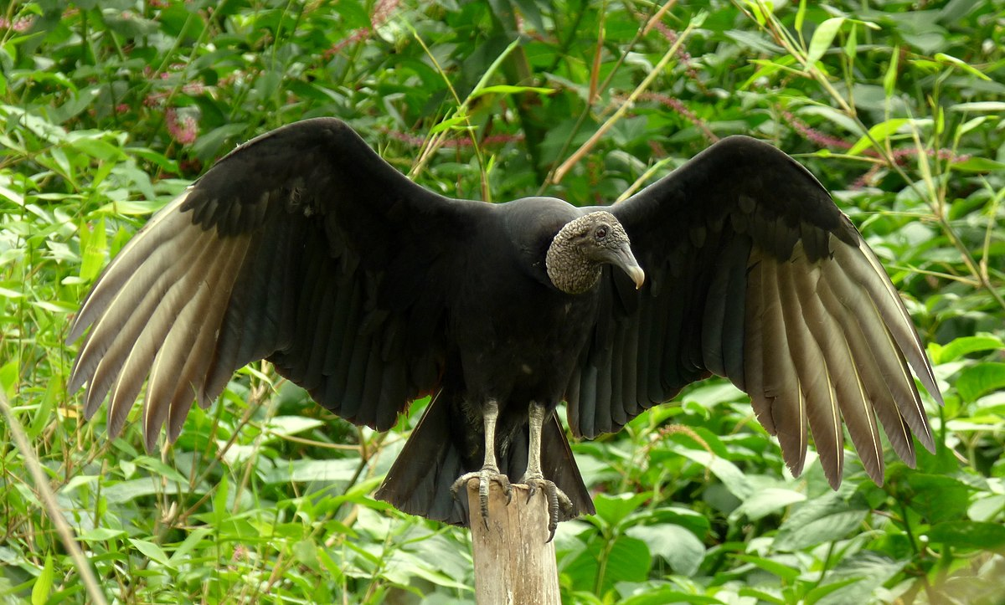
49 Cultivars Collected
amarilla
añera
andioca
palo negro Antonio
arahuana
palo negro Arimuya
arpón
blanca
blanca (palo negro)
blanca (palo blanco)
brava (cultivated)
brava (wild)
buena
bufeo
caballo
cerveza yuca
cogollo morado
crema
dulce
gallinazo
hungurahui
iguano
indianino
inviernino
lobera
lobera colorada
lobera negra
lupuna
lupunillo
mandioca amarilla
mano de tunche
morada
morada amarilla
motelillo
motelo
napino
palo negro
palmera
palo blanco
piririca
posheco enano
posheco gigante
puca umishina
rinrisho
señorita
umishina
vidrio
viejillo
yahua

Slide 16
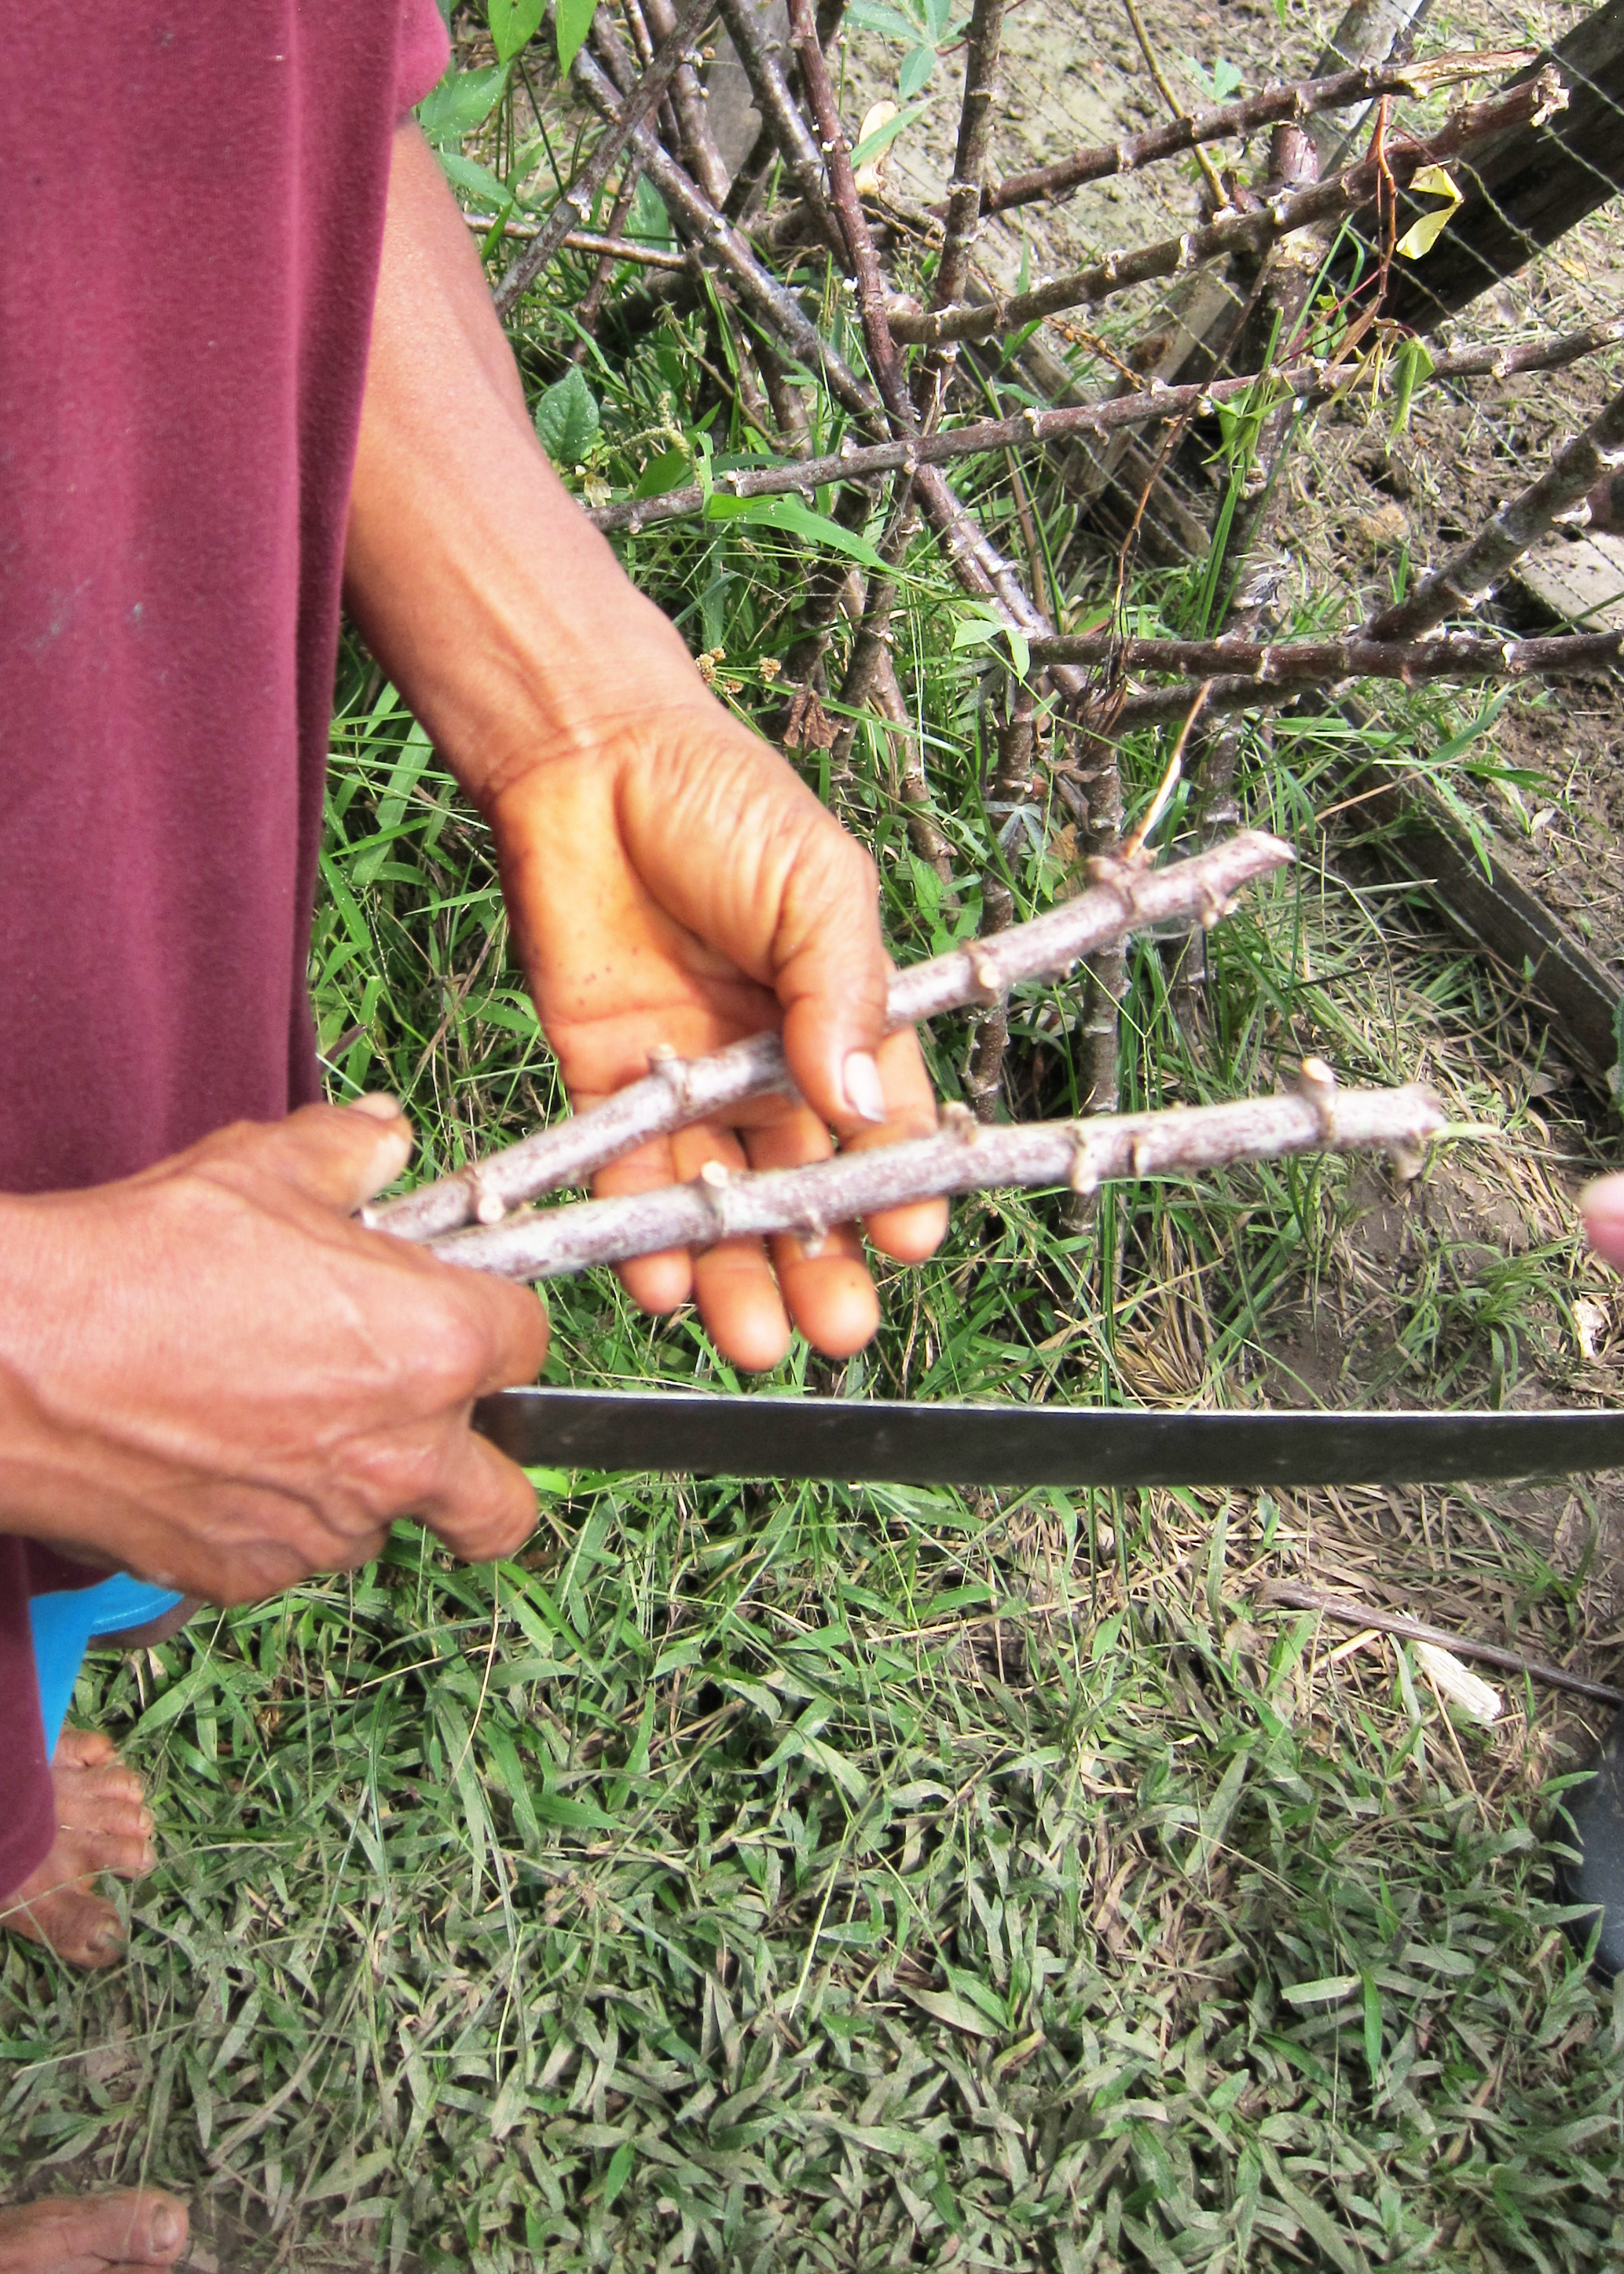
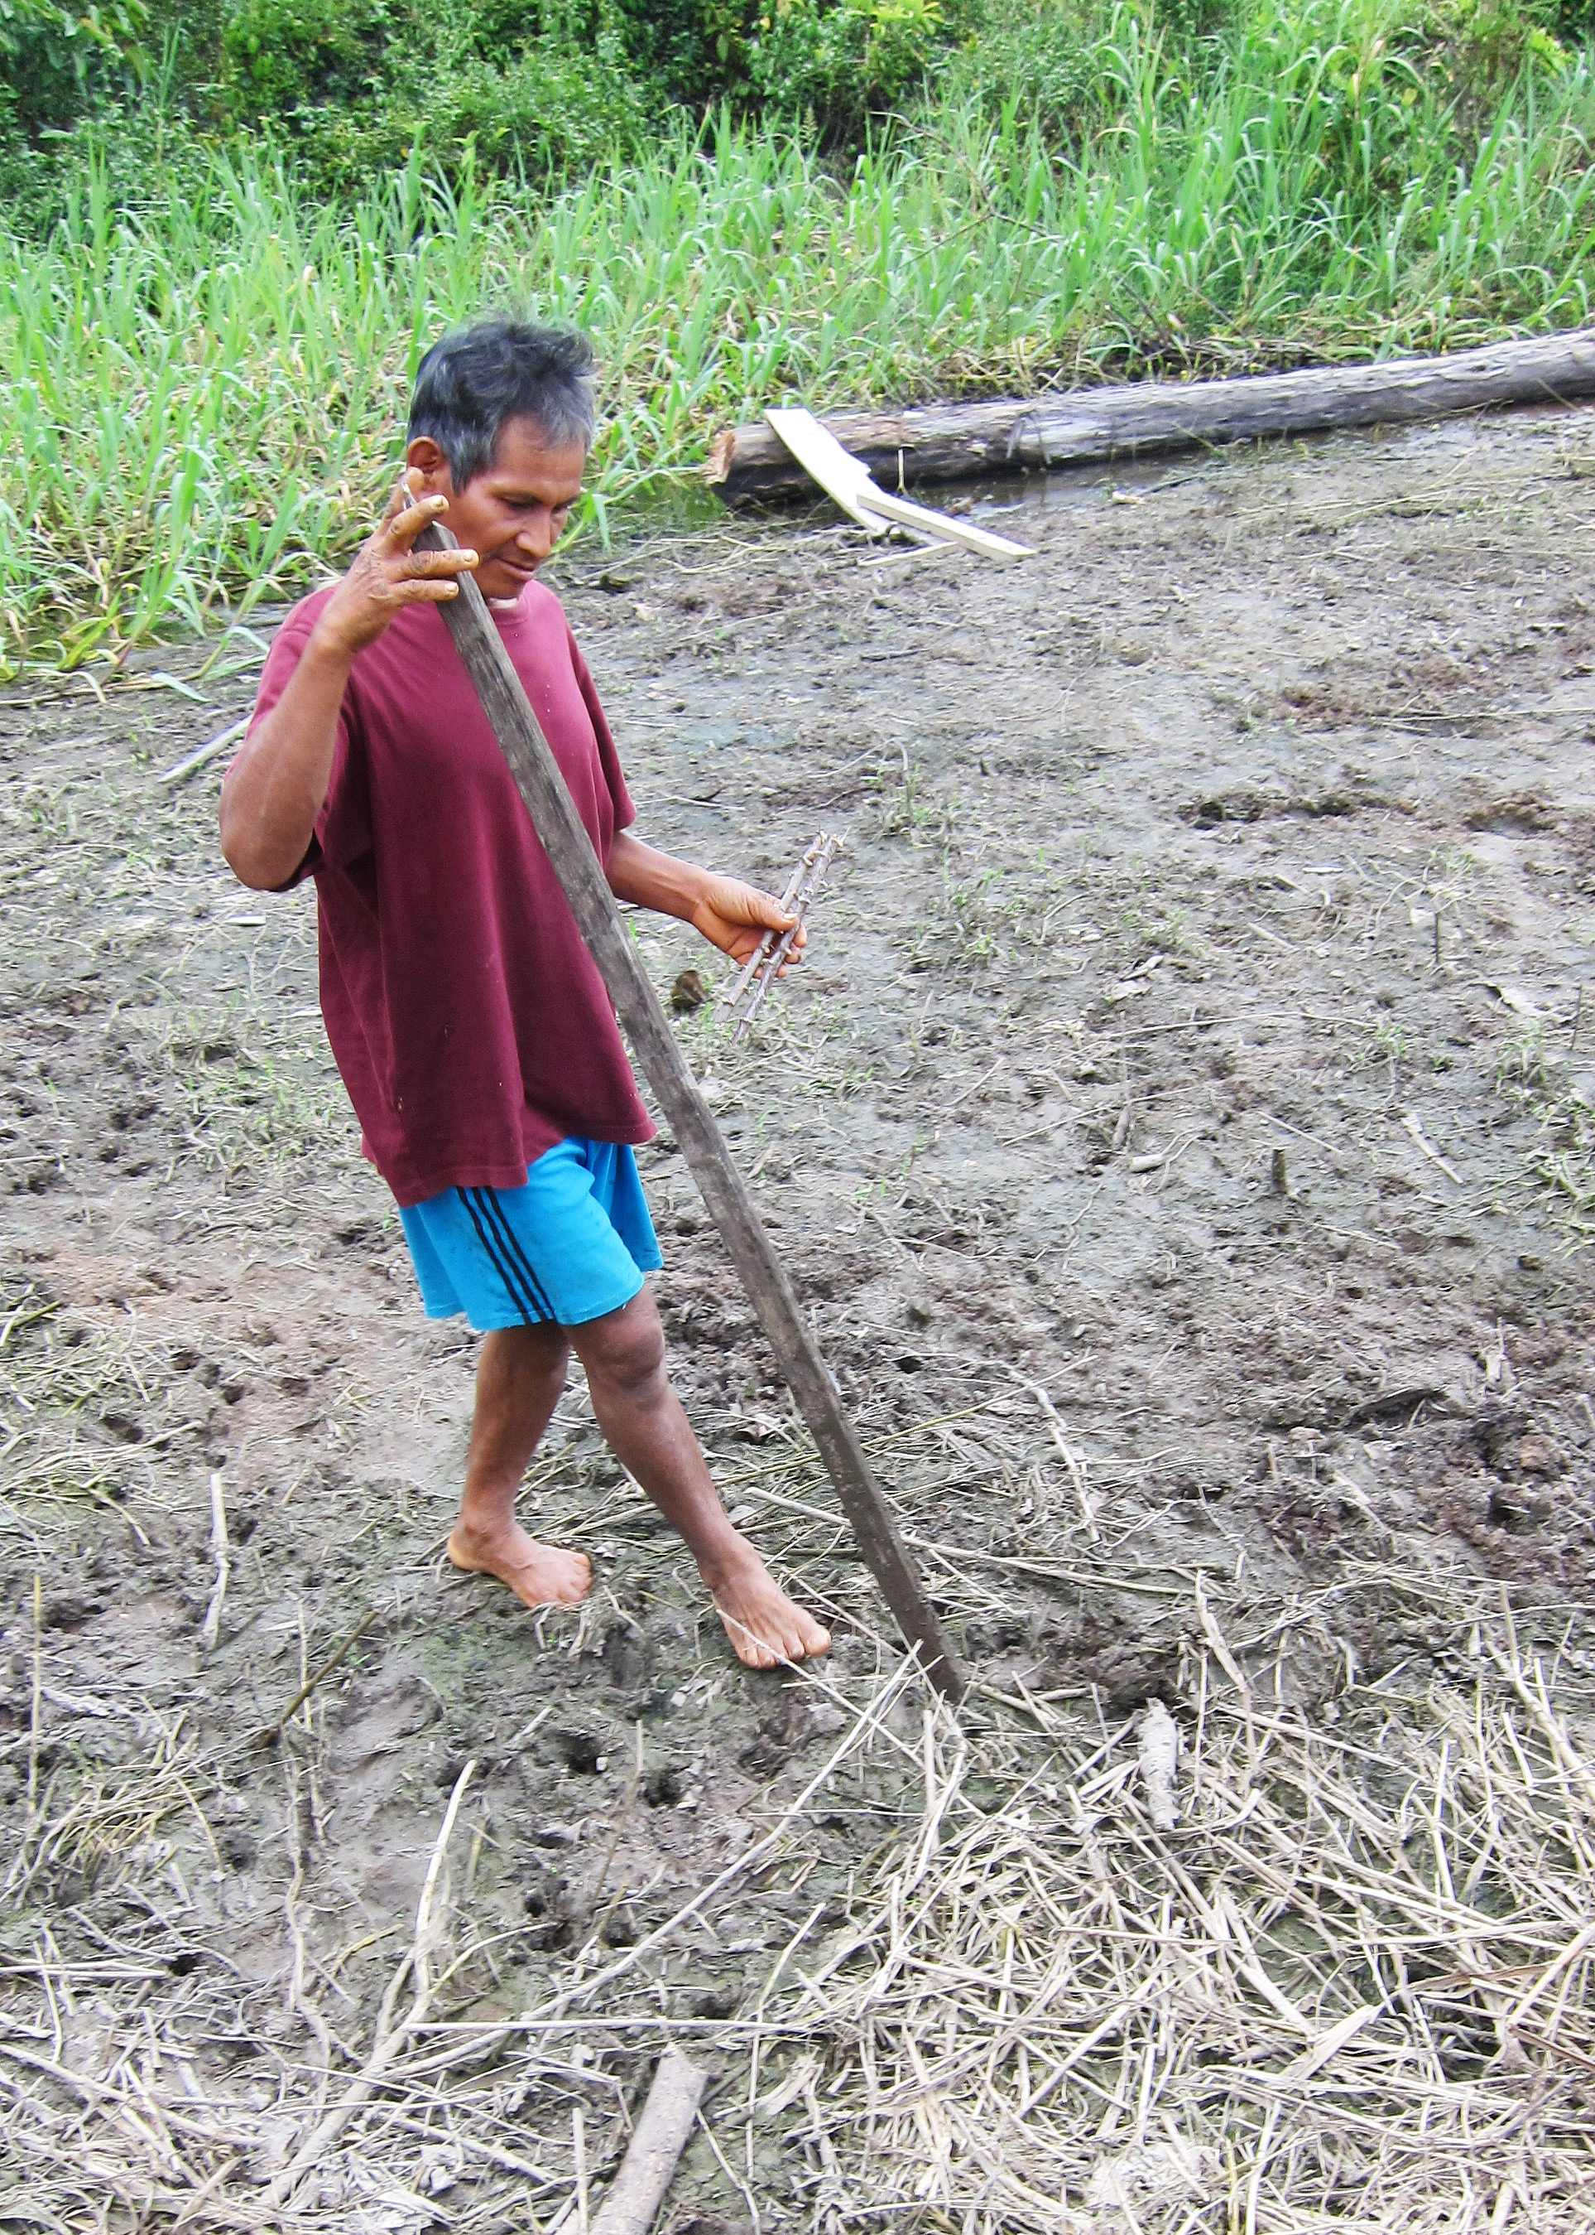
Cultivation Practices

Slide 17
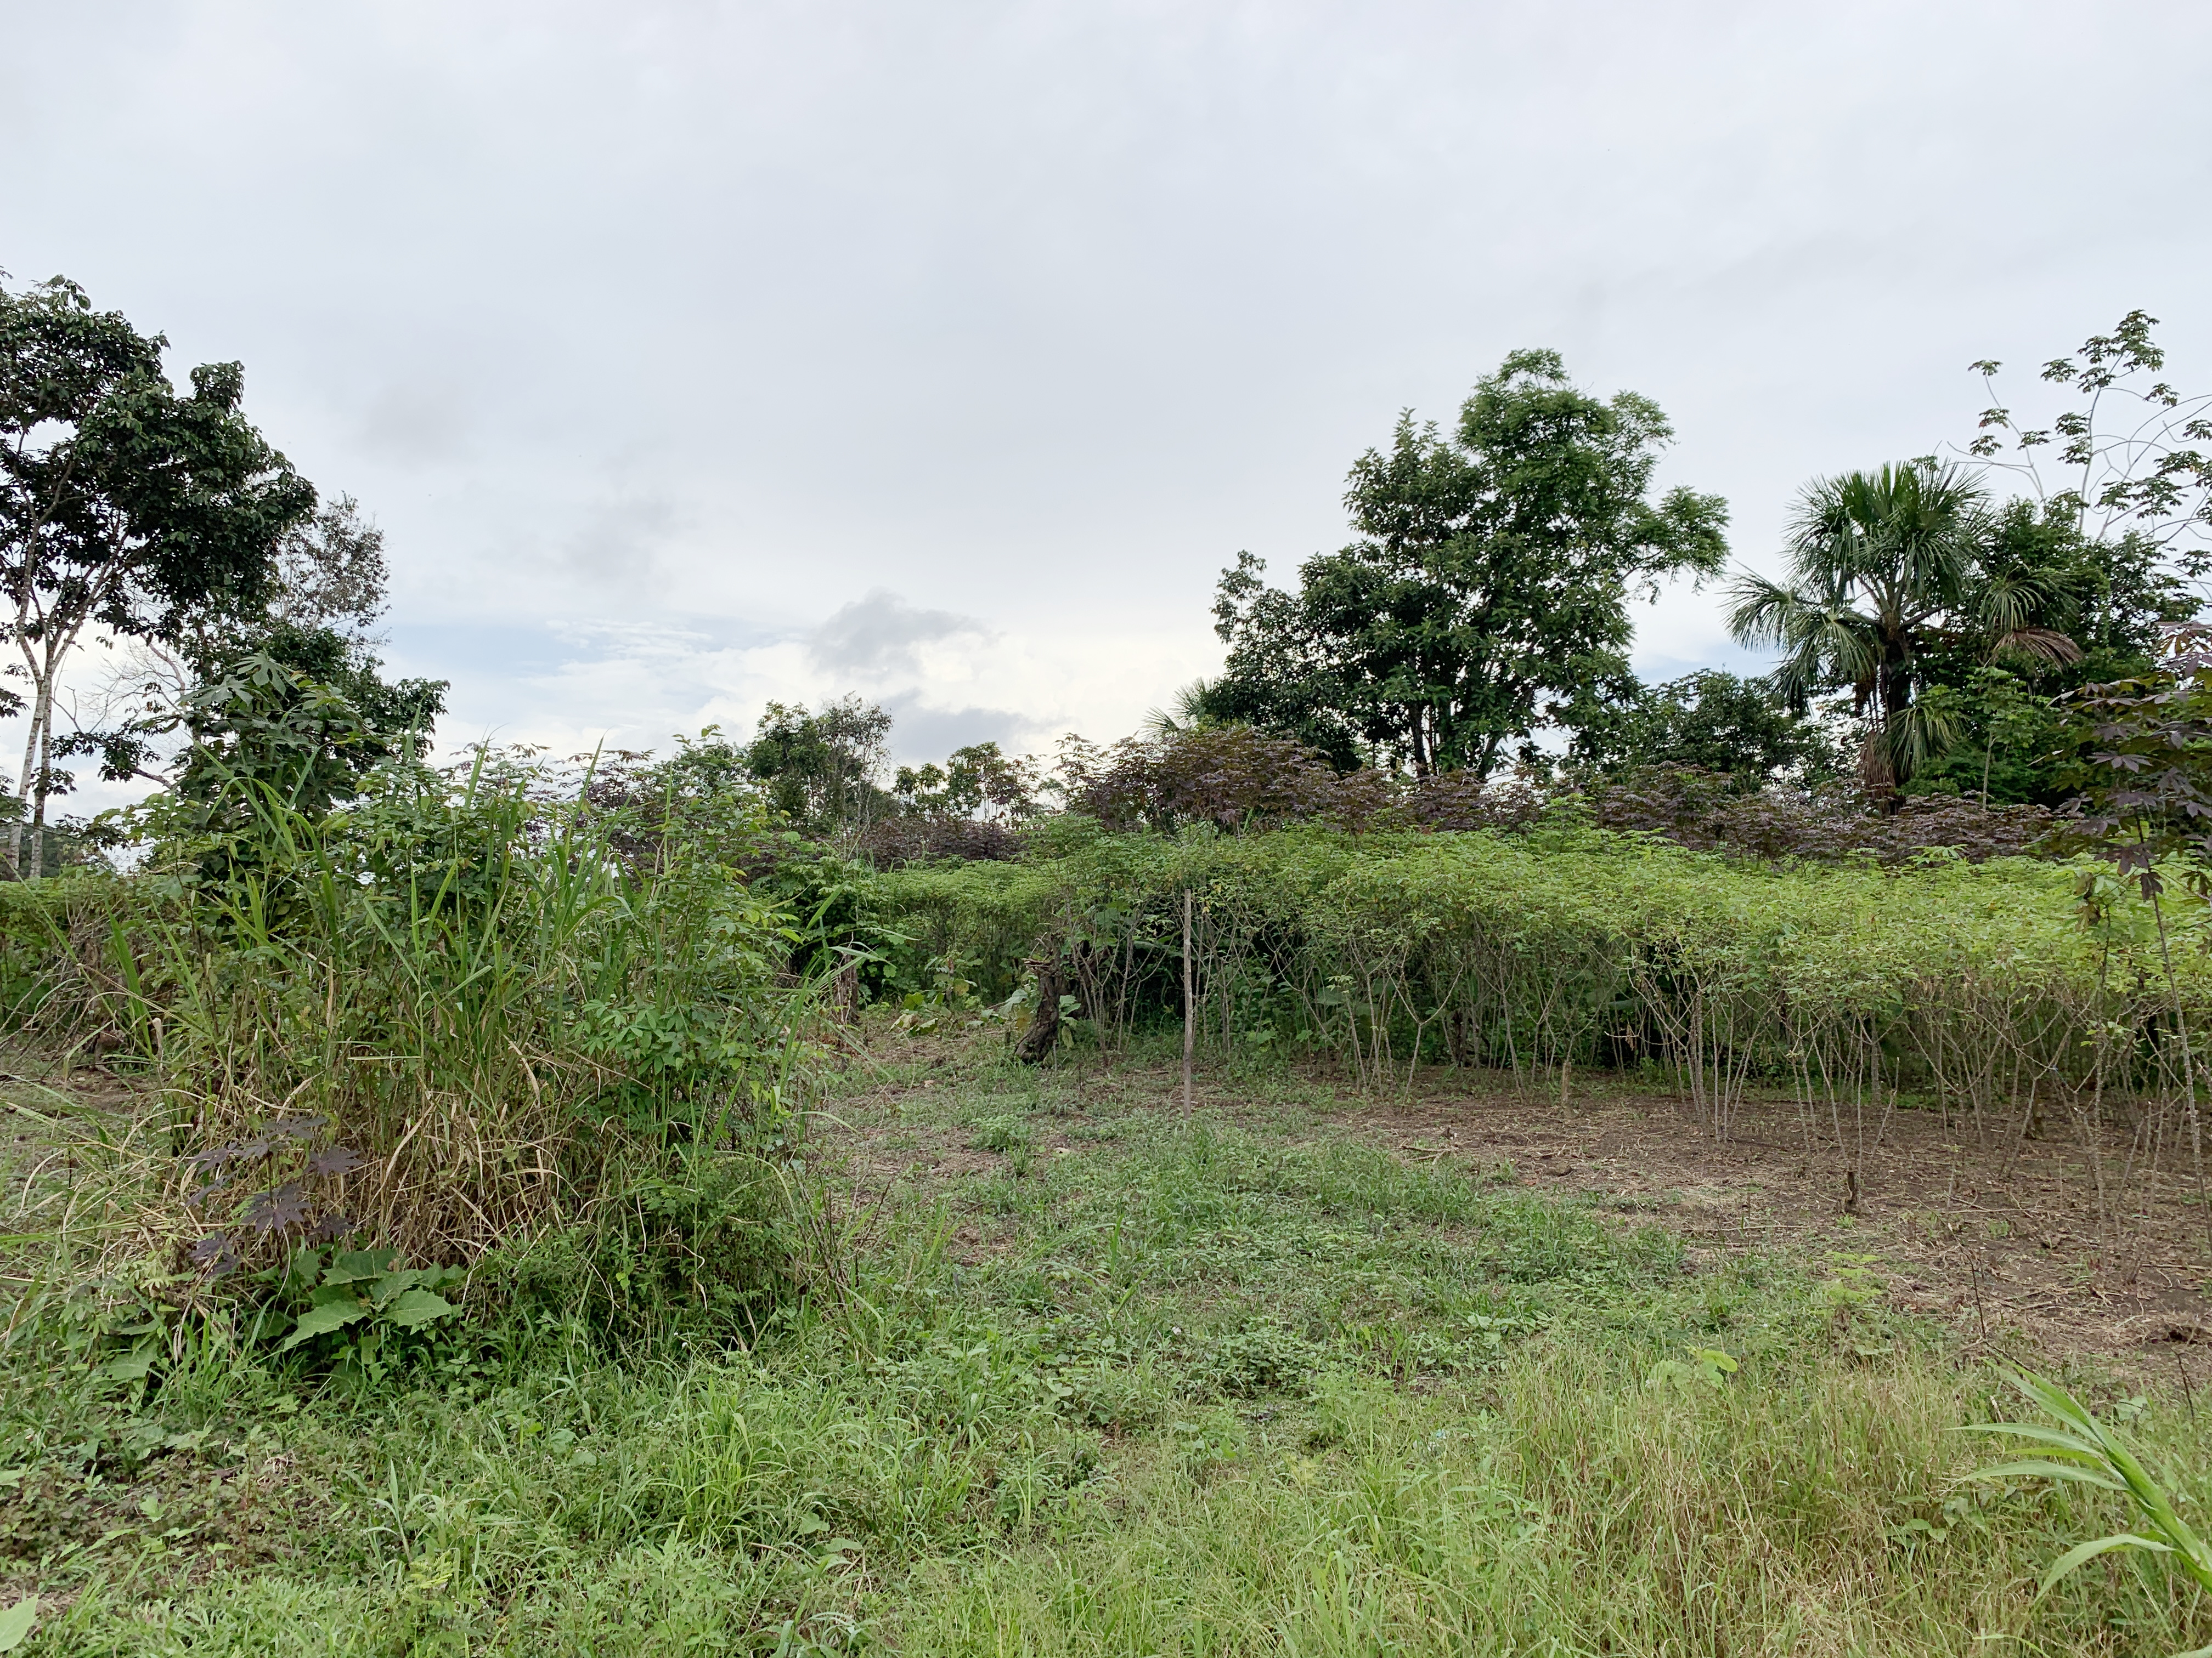
Cultivation Practices

Slide 18
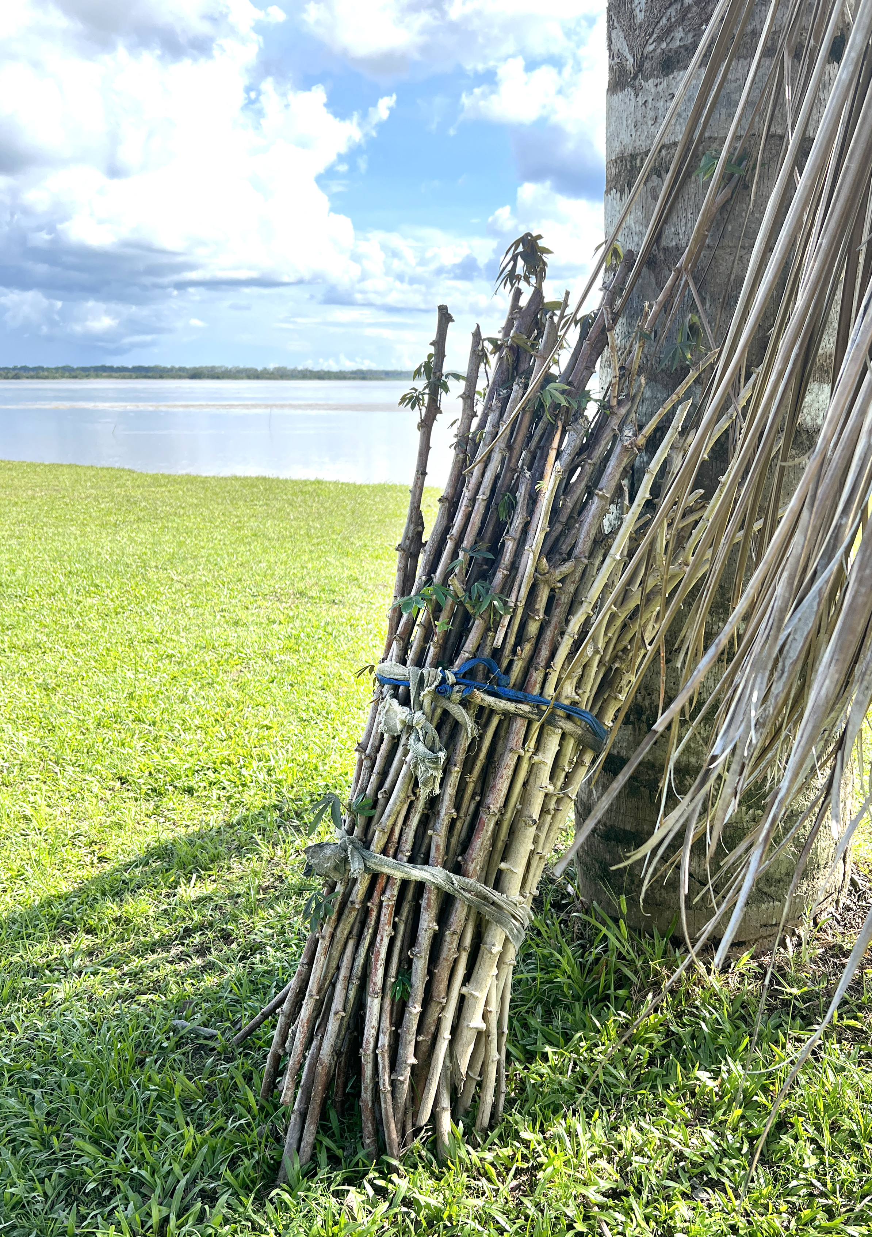

Slide 19
Cultivation Practices
Propagation clonal
New gardens derived from established ones
Restricts hybridization,
enhances cultivar stability
Multiple cultivars grown together (1 to 5)
Fruits were often observed
Abandoned chacras often grew ferally
Results in hybridization,
produces new cultivars

Slide 20
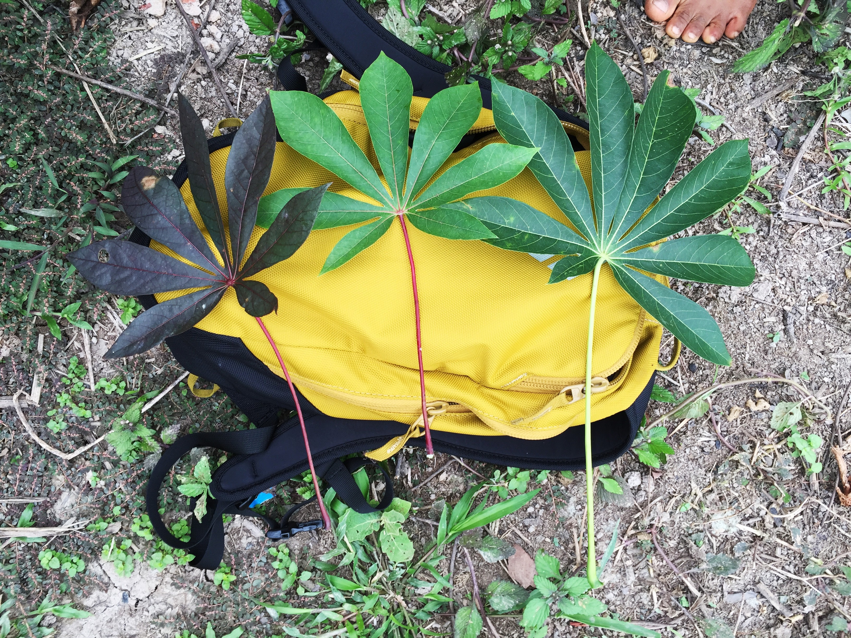
Biological Observations

Slide 21
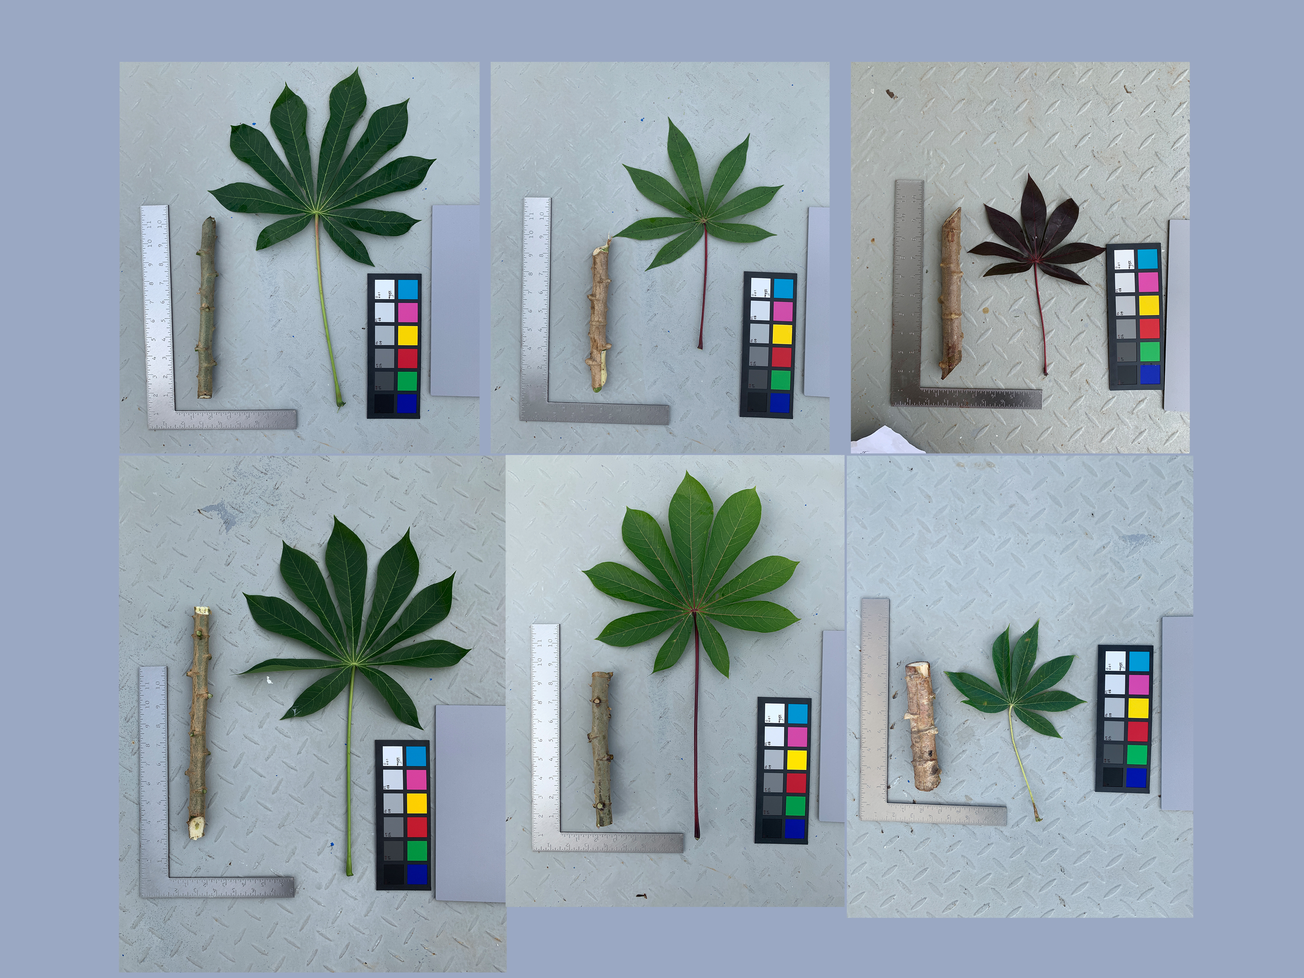
Señorita
Piririca
Palmera
Arpón
Amarilla
Añera

Slide 22
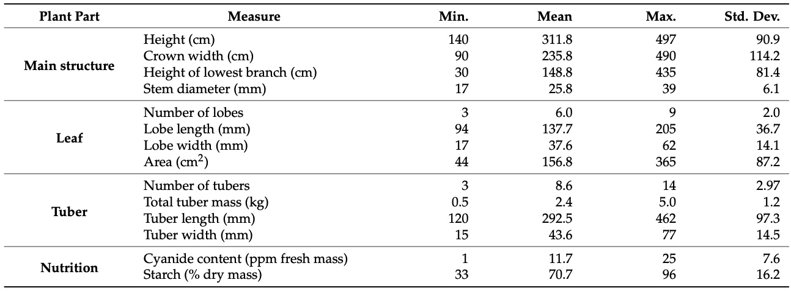
Statistical Summary

Slide 24
Correlations

Slide 25
Correlations
Highly significant correlations between many physical measures
No correlation between starch and –any- other measure.

Slide 26
Principal Components

Slide 27
Conclusions
Variation is extensive
Nomenclature
Phenotypes
Cultivation practices enforce isolation
Propagation is clonal
Utilizes recognized, mature plants
However, feral plots allow hybridization
Hybrids might be adopted as new cultivars
Starch shows evidence of selective pressure
Spatial structure is weak
Overlap among rivers
Migration rates likely high

Slide 28
Research in Progress: Genetics
Potential to reveal:
Evolutionary relationships
Evidence of hybridization
Population structure
Genotype-phenotype associations
Wooding, SP, Peña, CR. 2023. Genetic Diversity of Yuca (Manihot esculenta esculenta; Cassava, Manioc), an Indigenous Crop in the Peruvian Amazon. Diversity 2023, 15, 1158.

Slide 29
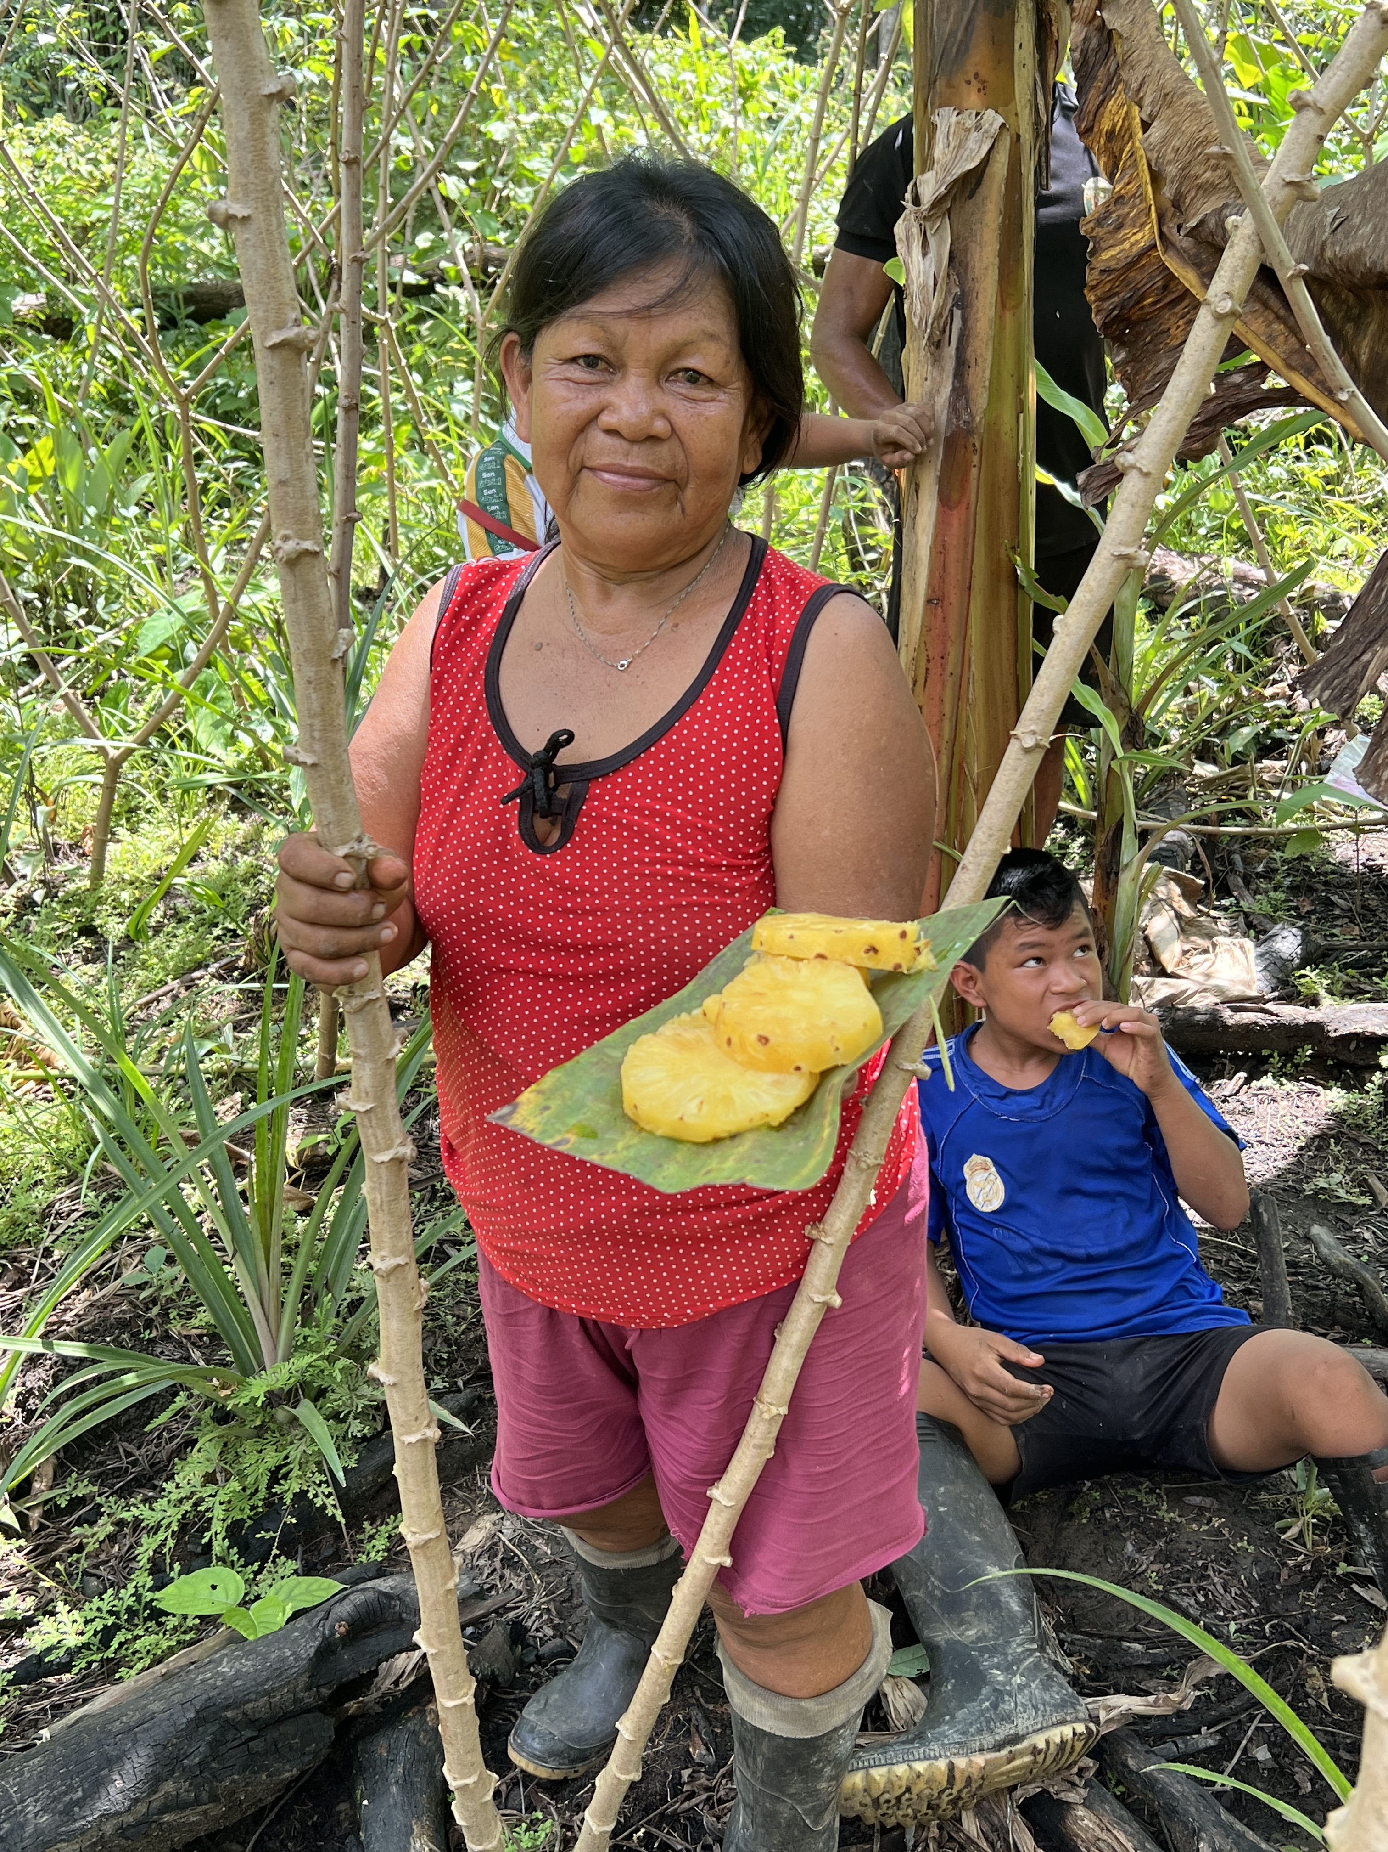

Slide 30
QR CODE
Download my slides here:
http://woodinglab.org/Wooding_SoE_2024

